Slide 1
THE APPLICATION OF COMPUTER VISION, MACHINE AND DEEP LEARNING ALGORITHMS UTILIZING MATLAB
Andrea Linda Murphy
Master of Science in Information Technology, Candidate
University of New Hampshire
Spring 2020

Slide 2
Introduction
The main objective of my thesis was to research and explore the field of data science. More specifically pertaining to the development of an object recognition application that could be built entirely using MATLAB’s IDE, and have a positive social impact on the deaf community. And in doing so, answering the question, could MATLAB be utilized for development of this type of application?
To simultaneously answer this question while addressing my main objectives, I constructed two different object recognition protocols utilizing MATLAB_R2019 and the add-on data science tool packages. I named the protocols ASLtranslate (I) and (II). This allowed me to experiment with all of MATLAB’s data science toolboxes while learning the differences, benefits, and disadvantages of using multiple approaches to the same problem.

Slide 3
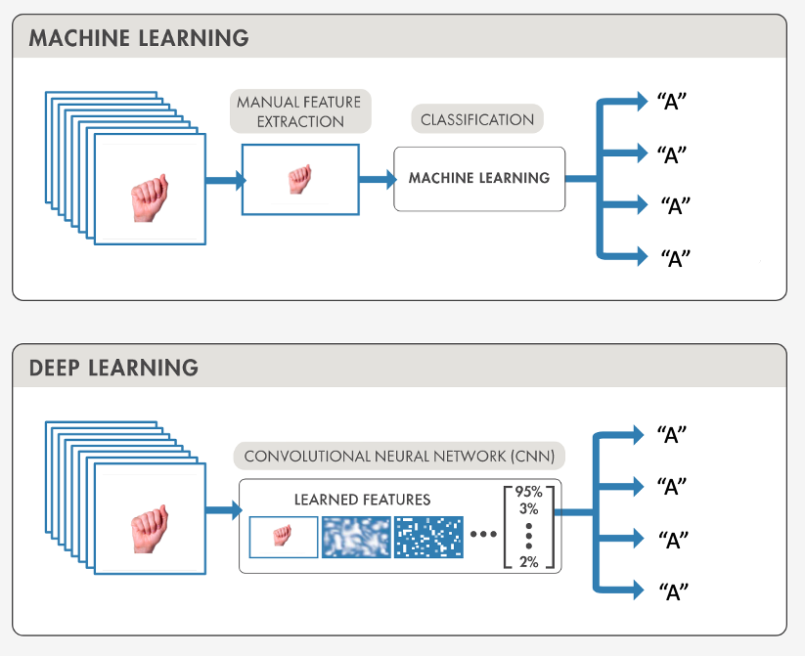
Methodology and Approach- Design
ASLtranslate (I)
ASLtranslate (II)

Slide 4

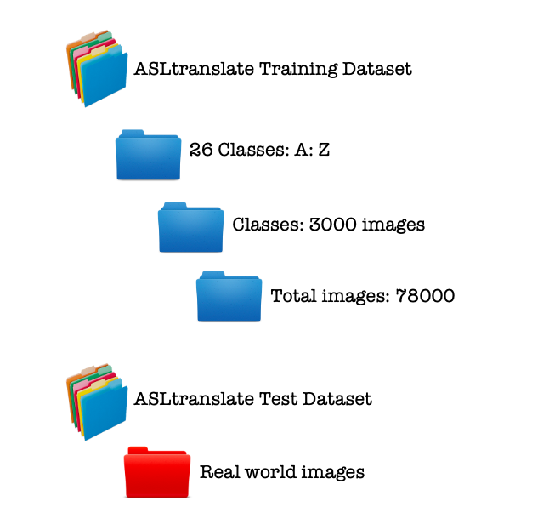
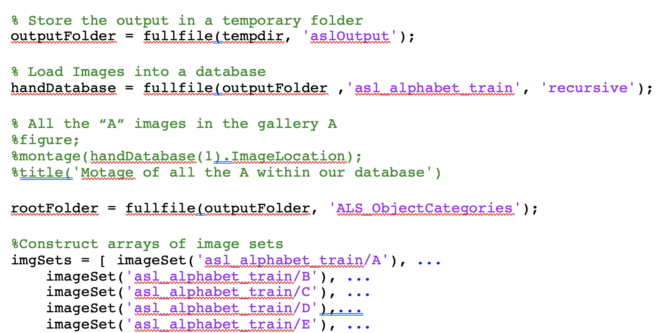
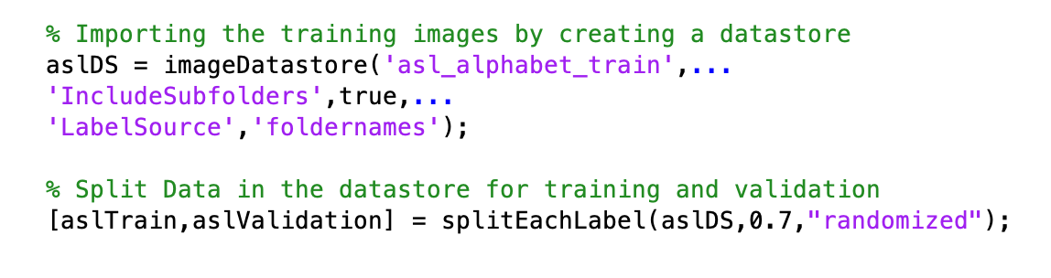
Methodology and Approach- Data
ASLtranslate (II)
ASLtranslate (I)

Slide 5
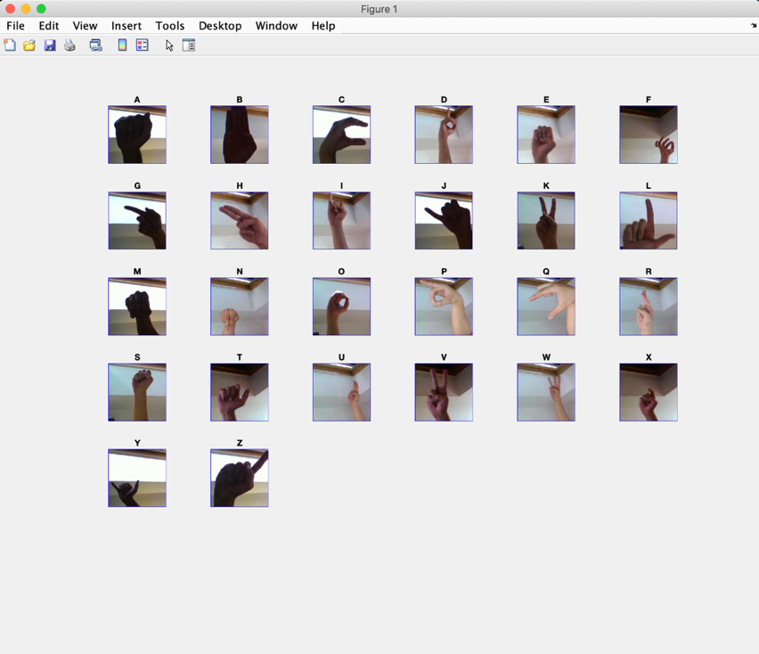
Methodology and Approach- ASLtranslate (I)
>> { imgSets.Description }
ans =
1×26 cell array
Columns 1 through 16
{'A'} {'B'} {'C'} {'D'} {'E'} {'F'} {'G'}
{'H'} {'I'} {'J'} {'K'} {'L'} {'M'} {'N'}
{'O'} {'P'}
Columns 17 through 26
{'Q'} {'R'} {'S'} {'T'} {'U'} {'V'} {'W'}
{'X'} {'Y'} {'Z'}
Results after applying the imgSets method to the dataset

Slide 6
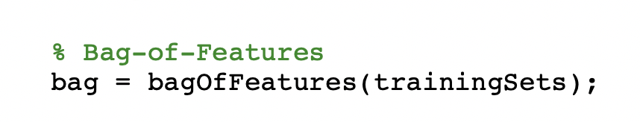
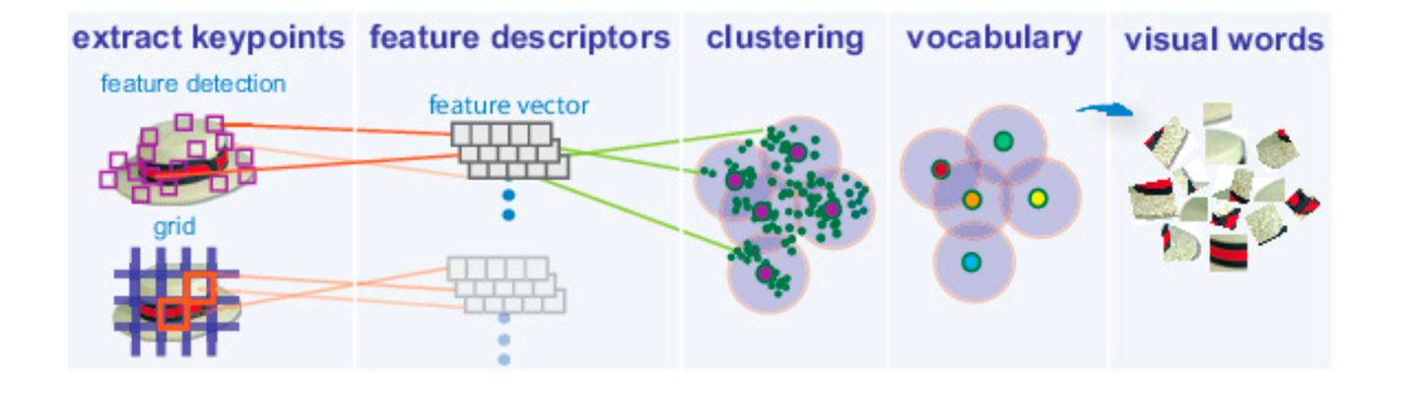
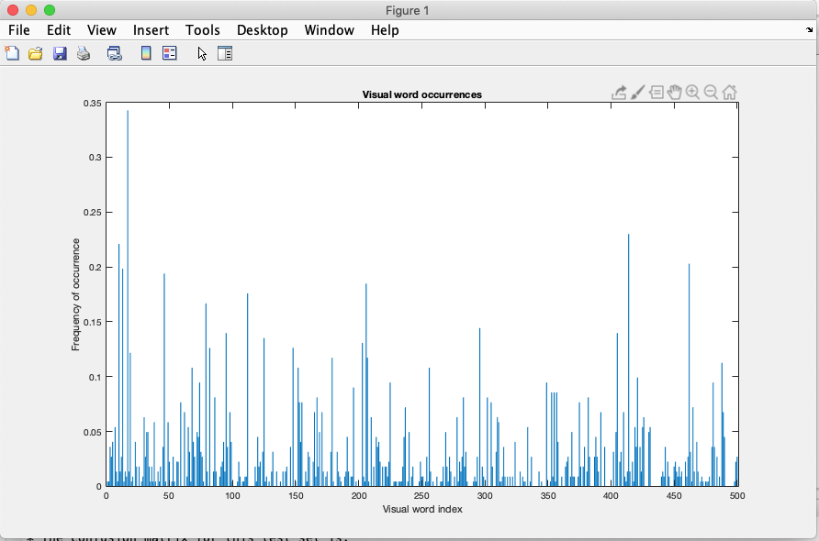
Methodology and Approach- bag-of-visual-words (BOVW)
ASLtranslate (I)

Slide 7
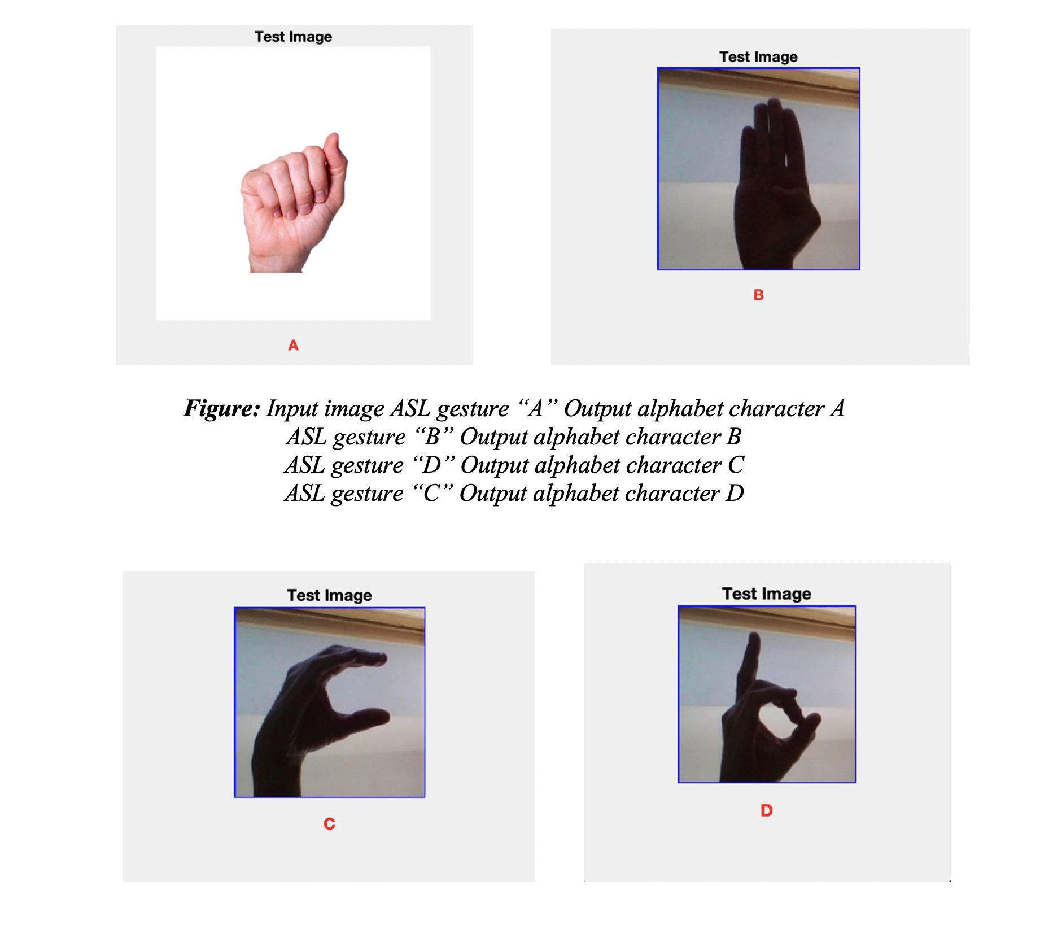
Results- ASLtranslate (I)

Slide 8
Methodology and Approach- Transfer Learning Using AlexNet
ASLtranslate (II)

Slide 9
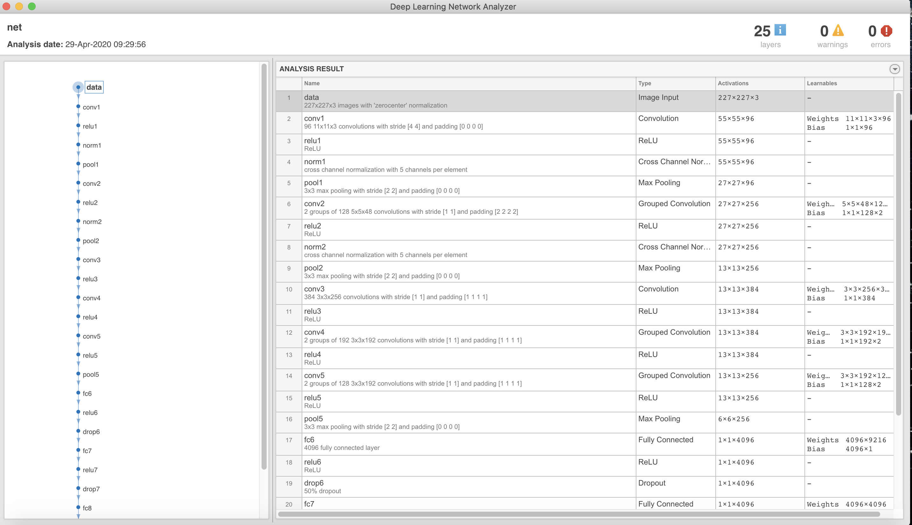
Methodology and Approach- Transfer Learning Using AlexNet
ASLtranslate (II)

Slide 10
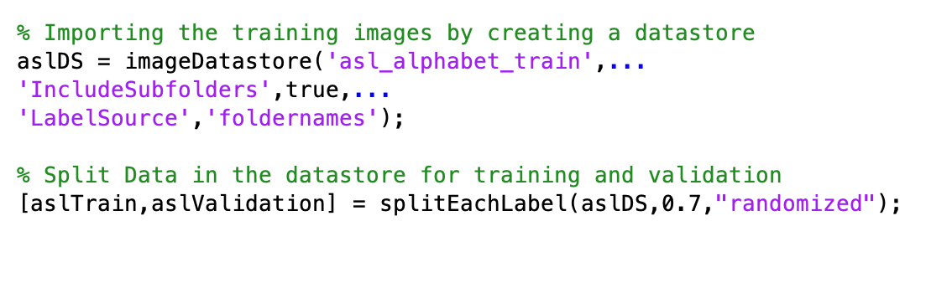
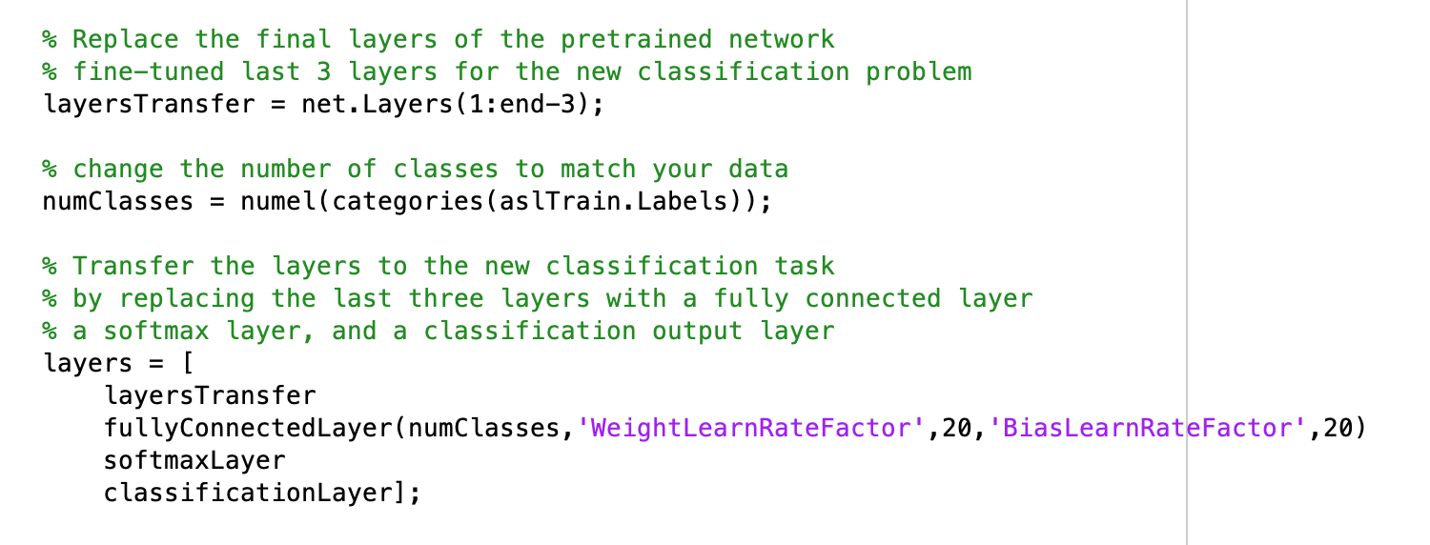
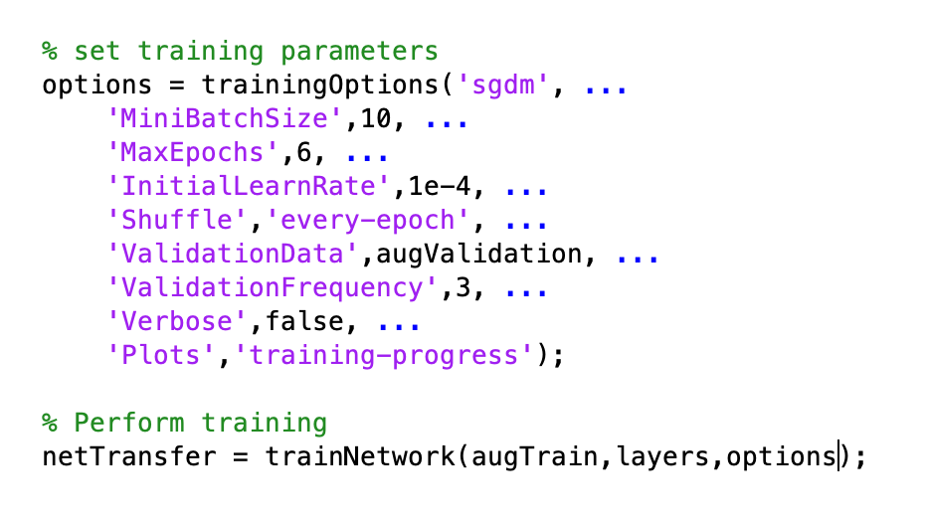
Methodology and Approach- Transfer Learning Using AlexNet
ASLtranslate (II)
To perform transfer learning in MATLAB, you need to first create three components

Slide 11
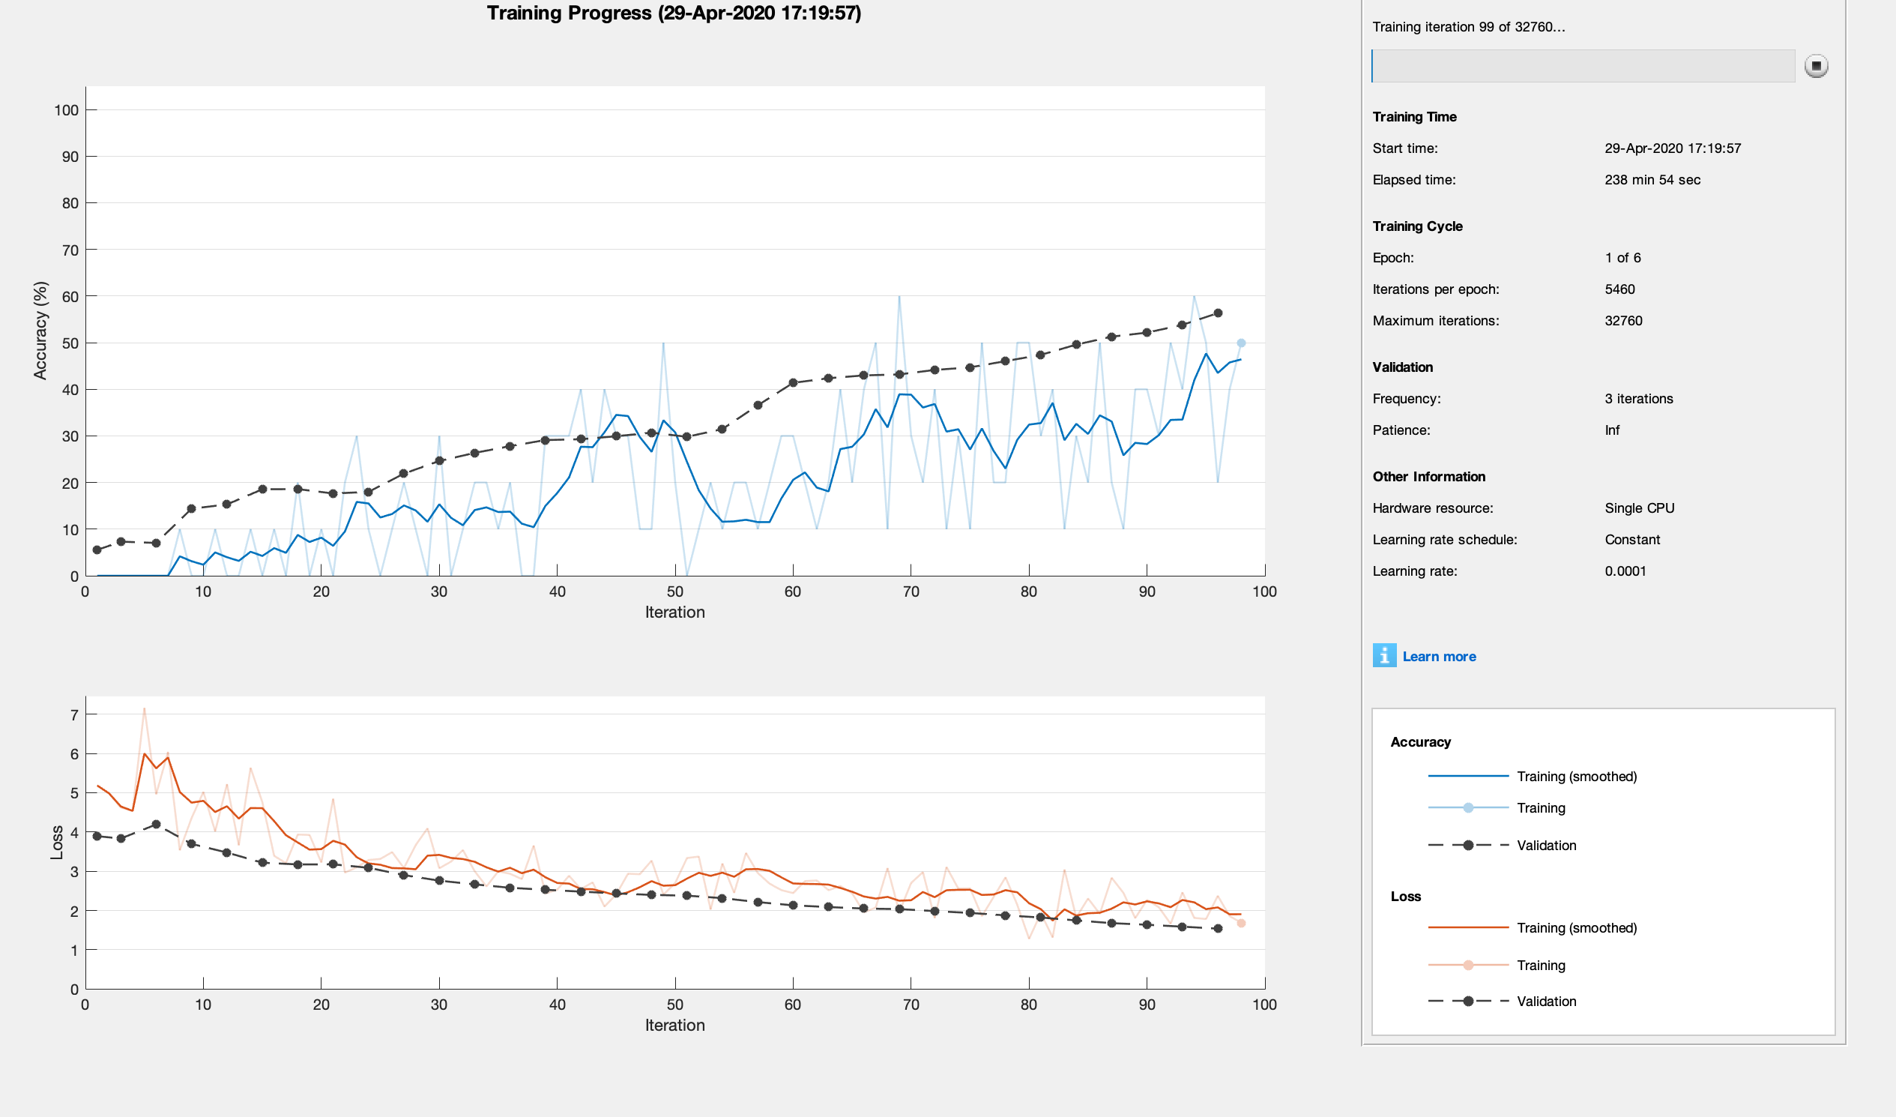
Methodology and Approach- Training Progress
ASLtranslate (II)
Accuracy and Loss Metrics
Training Accuracy:
Classification accuracy
on each individual mini-batch.
Smoothed Training Accuracy:
Obtained by applying a smoothing algorithm
to the training accuracy.
Validation Accuracy:
Classification accuracy on the entire
validation set.
Training Loss, Smoothed Training Loss,
and Validation Loss:
The loss on each mini-batch,
its smoothed version,
and the loss on the validation set.

Slide 12
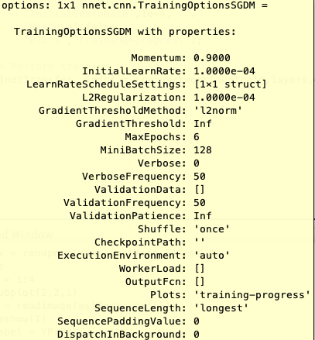
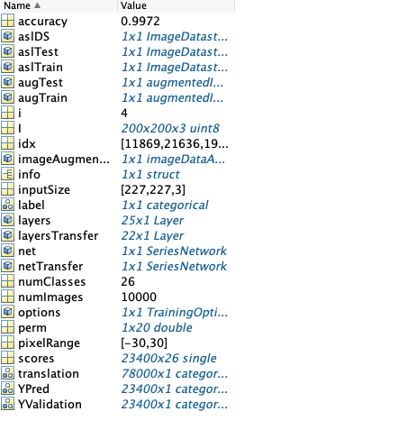
Results- ASLtranslate (II)

Slide 13
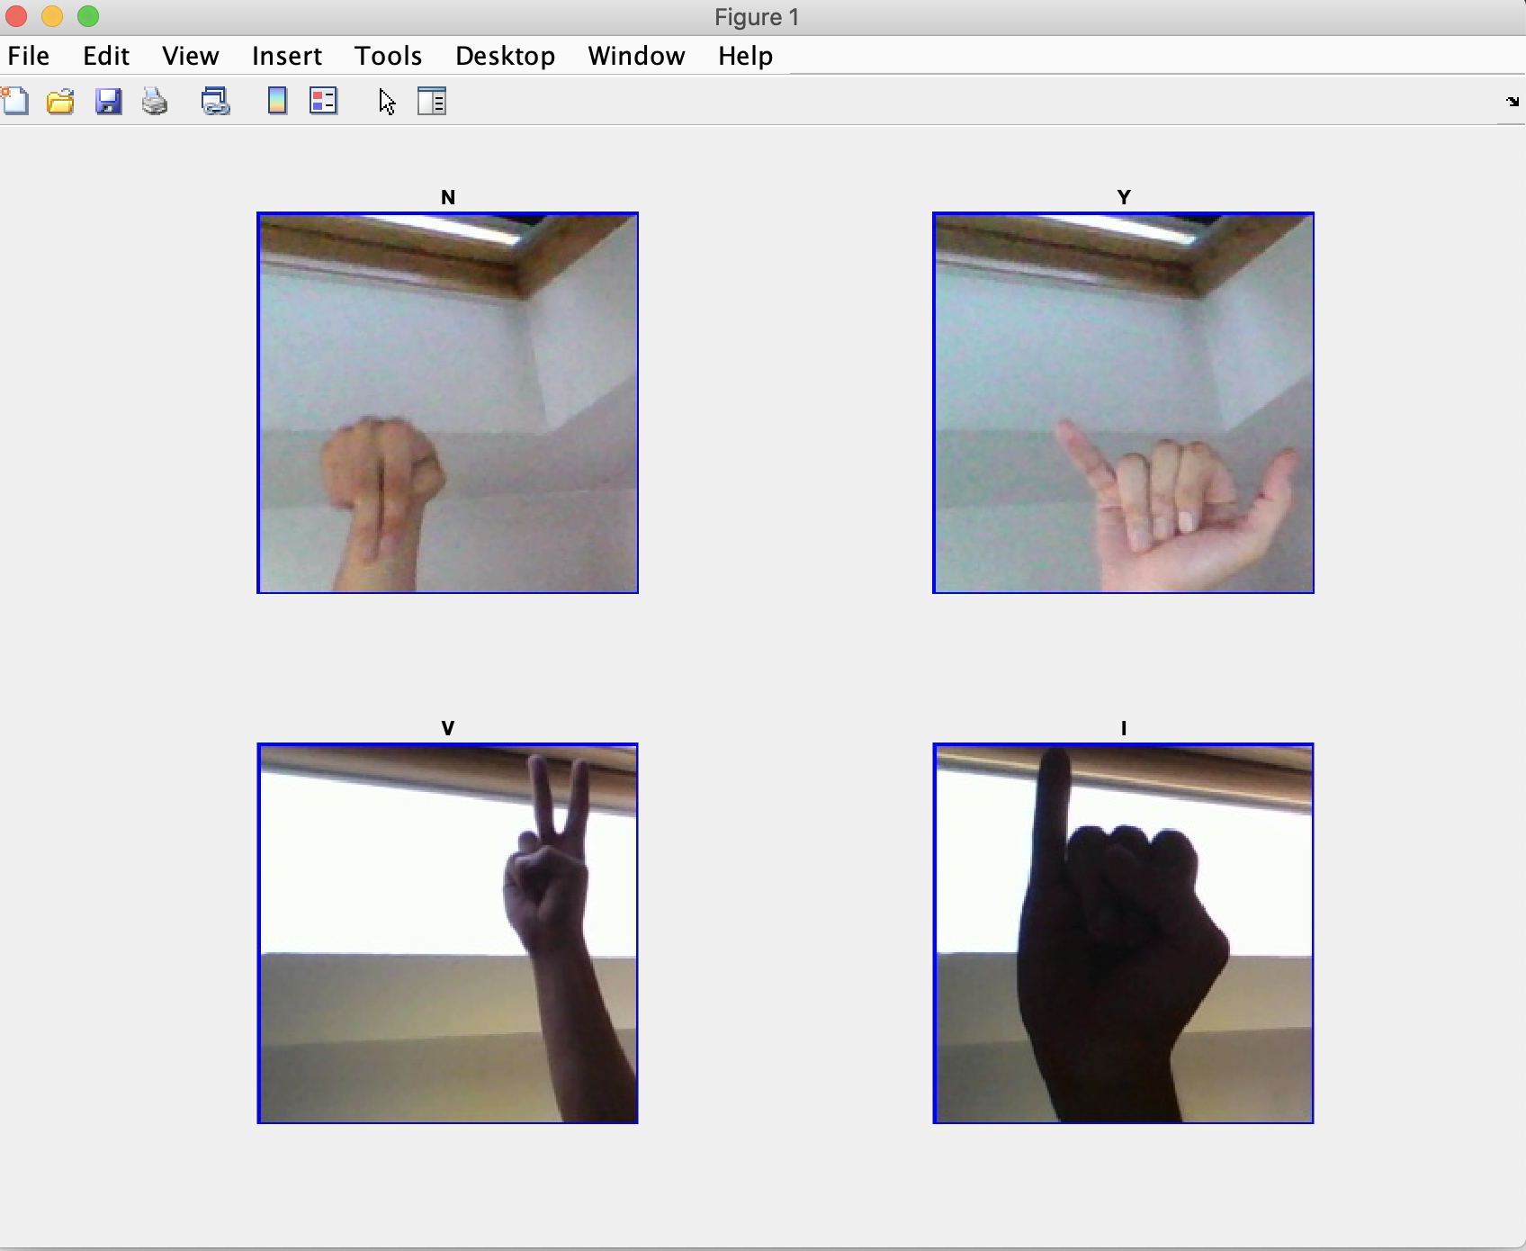
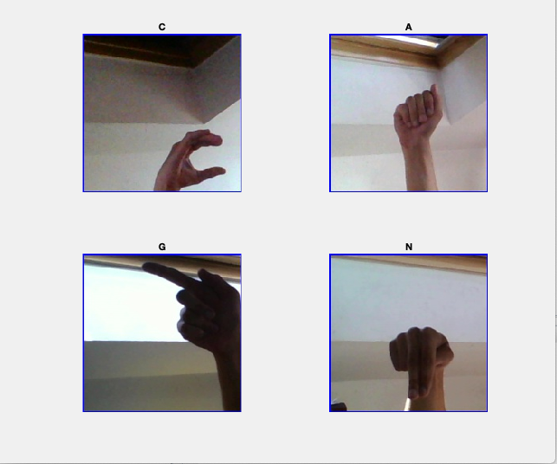
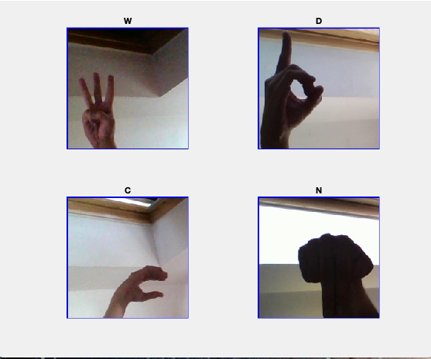
Results- ASLtranslate (II)

